Slide 1
Git & Github for the UseR
library(dplyr)
rladies_global %>%
filter(city == 'Charlottesville')
Pick up a temporary parking pass!
Wifi: VividCortex_Guest
Follow us on Twitter: @RLadiesCville
May 1, 2018

Slide 2




Sponsors + Friends (for now)
Look at all of this empty space!

Slide 3
Agenda for today:
Intro to Git & Github
Demo & follow along
Troubleshooting
Questions & Resources

Slide 4

1.
What is ?

Slide 5
What is Git?
Git is a free and open sourced distributed version control system.
It manages the evolution of set of files, or repository, between local and online versions
It allows other people to see your stuff, sync up with you, and perhaps even make changes.

Slide 6

2.
What is ?

Slide 7
What is Github?
Github is a web-based hosting service for version control – it’s where the online backup of your local project lives.
Github allows a project to have multiple, independent branches of development, with the notion that some should eventually be merged back into the main development branch.
In addition, there are two other important features of Github:
Issues: list of bugs, feature requests, to do’s, etc.
Pull requests: a formal proposal that says “Here are some changes I would like to make.” (It might be linked to a specific issue)

Slide 8




3. + + =

Slide 9
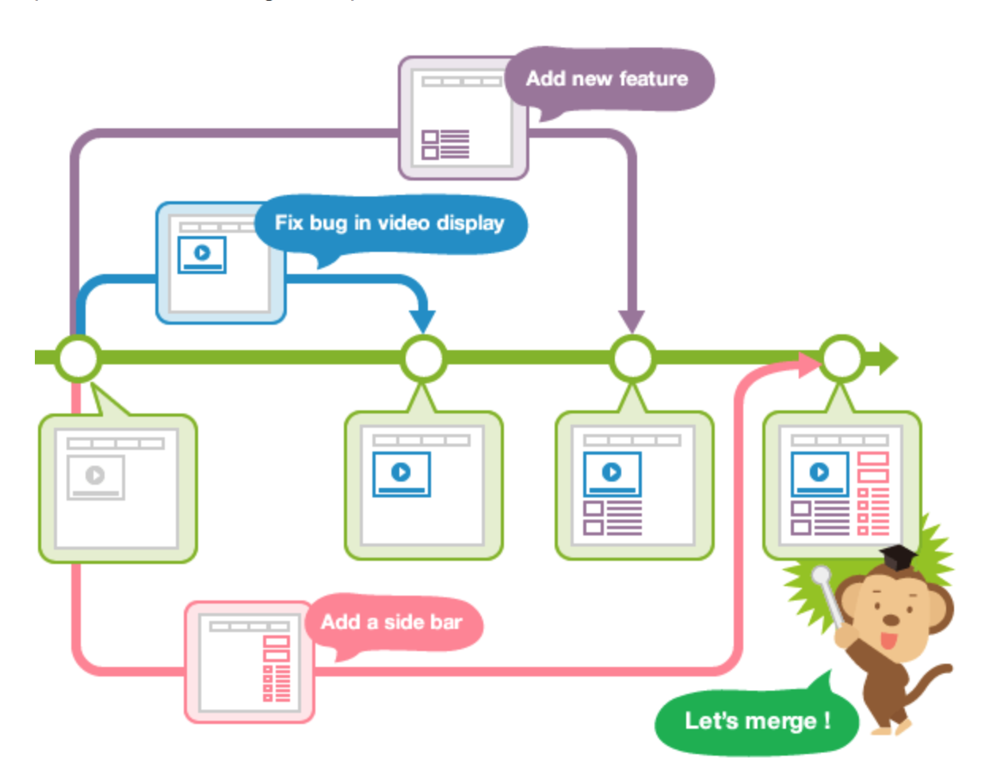
Terminology to Know
Local (on your computer) vs. Remote (on the internet)
Repository: a place where the history of your work is stored
Origin: the default name of the remote repository
Master: name of your default branch – the deployable version
Branch: a way to maintain different versions of the same code base. When you create a branch in your project, you're creating an environment where you can try out new ideas and if they work, you can merge them back to the master
Notes:
There are actually three things here: origin master is two separate things, and origin/master is one thing. Three things total.
Two branches:
master is a local branch
origin/master is a remote branch (which is a local copy of the branch named "master" on the remote named "origin")
One remote:
origin is a remote

Slide 10
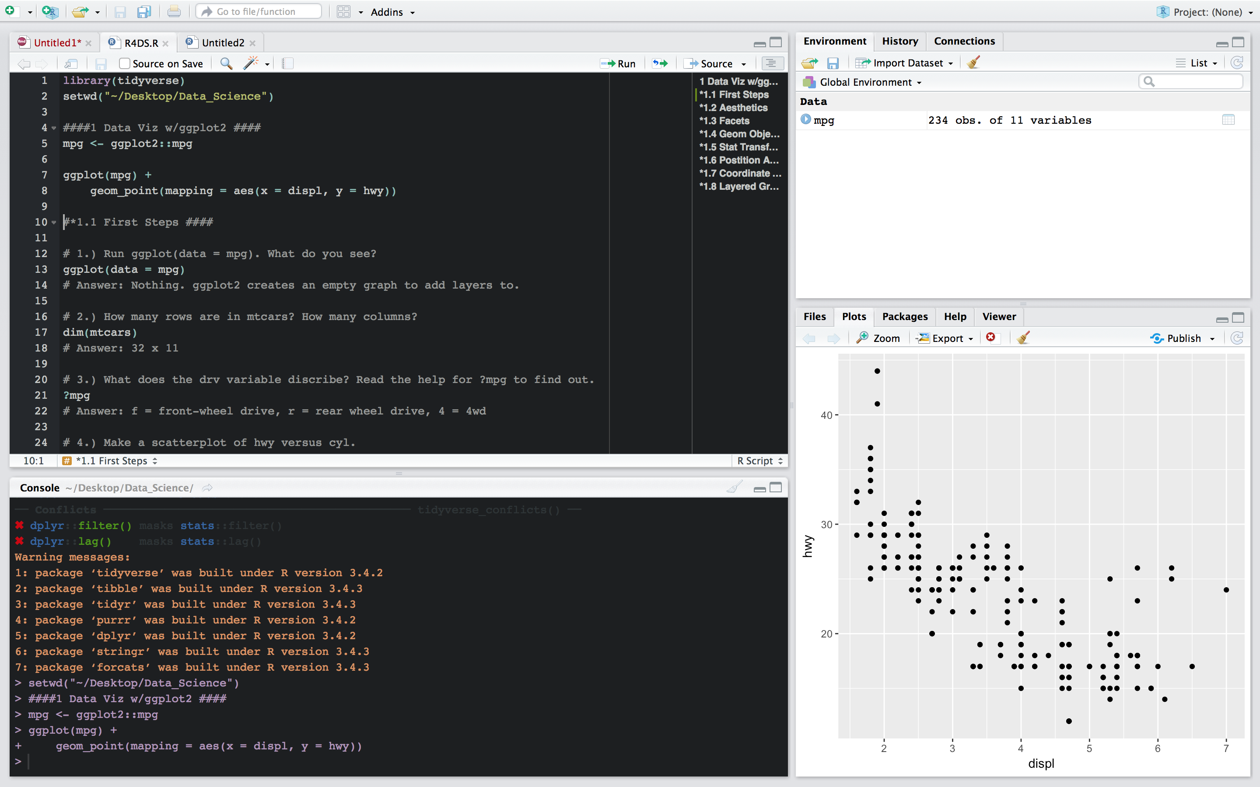
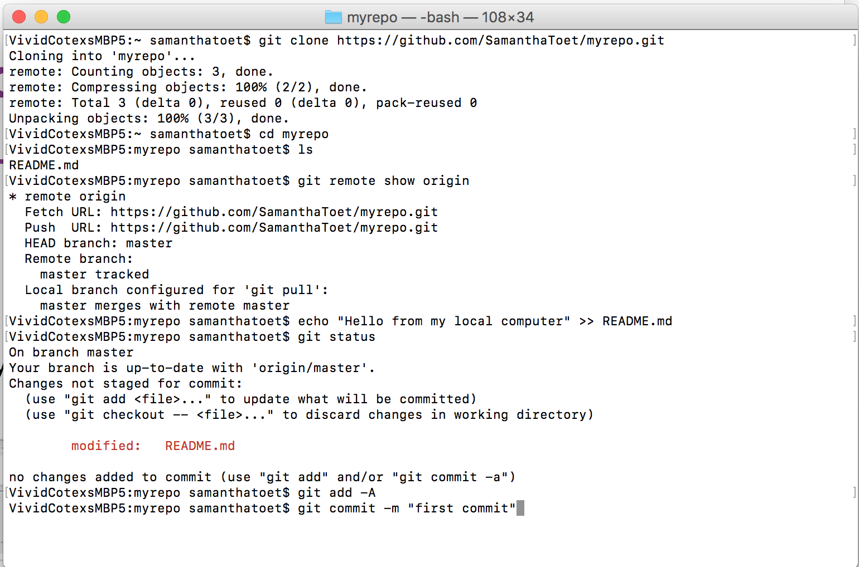
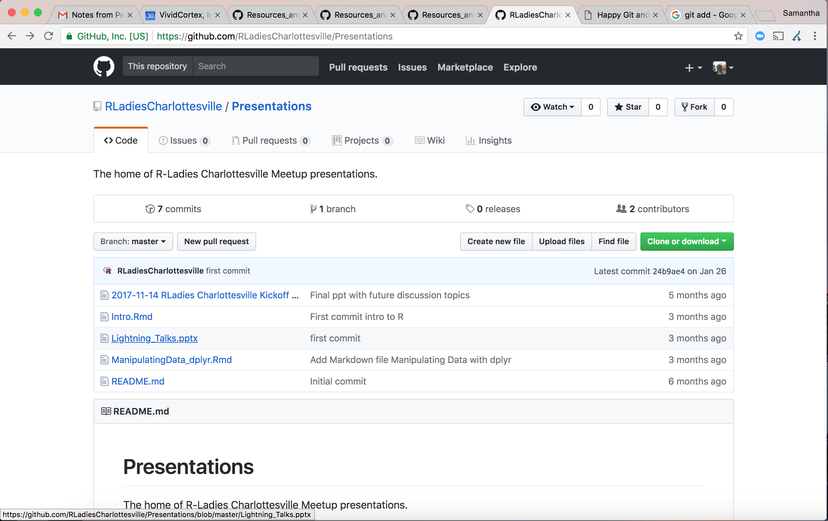
How does it work?
Rstudio
Used locally
Where the coding magic happens
Files saved locally in folders
Git
Used at the command line
Repository = folder
Committing saved local files to staging (i.e. saving as multi-file snapshot)
Github
Used online
Push your local commits to Github periodically
Share your work and collaborate with others

Slide 11
Walkthrough: Getting Started
Register a free Github account
Download and install Git
Introduce yourself to Git
Get local Git talking with Github
Make a local change, commit, and push
Extra credit: pull from a remote

Slide 12
1.) Register a free Github account
https://github.com
Try to keep your username simple (EX. Hauncher and RLadiesCharlottesville might not be the best choices ¯\_(ツ)_/¯ )

Slide 13
2.) Download and Install Git
If you think you might have Git already installed, check which version:
In the command line, type: git --version
If your version is less than 2.15.1, you’ll need to update or reinstall:
Mac: In the command line, type: xcode-select –install then accept and follow the prompts
Windows: Install Git Bash for Windows at https://gitforwindows.org/
If neither of those options work, download directly from the website: http://git-scm.com/downloads.

Slide 14
3.) Introduce yourself to Git
In the terminal, type your information:
Make sure to use the same email that you signed up for Github with!

Slide 15
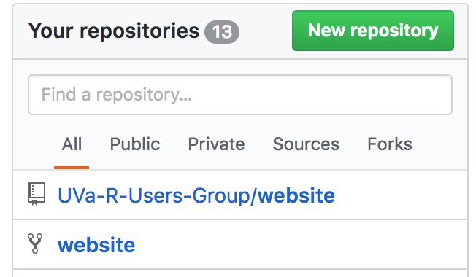
4.1.) Create Github Repository
To create a new repository on Github:
Log on to Github and click the green, “New repository” button
Name it “myrepo” (we’ll delete this after)
Note that Git and GitHub are case sensitive
Give it a short and meaningful description
Select Public
Check “Initialize this repository with a README”
Click the green “Create Repository” button
Notes:
This is where I start coding along

Slide 16
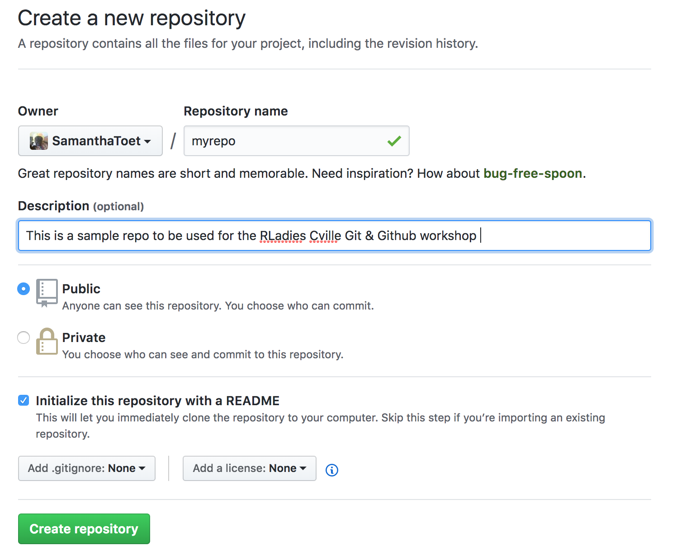

Slide 17
4.2.) Prepare your working directory
In your terminal, check which directory you’re currently in:
pwd prints your working directory (similar to getwd() in R)
cd changes your current working directory (similar to setwd()in R)
For this exercise, I would recommend using setting your working directory to your Desktop, that way you can more easily see the changes:
On Github, go to your new repository, and click on the green “Clone or Download” button. Then copy the link provided.

Slide 18
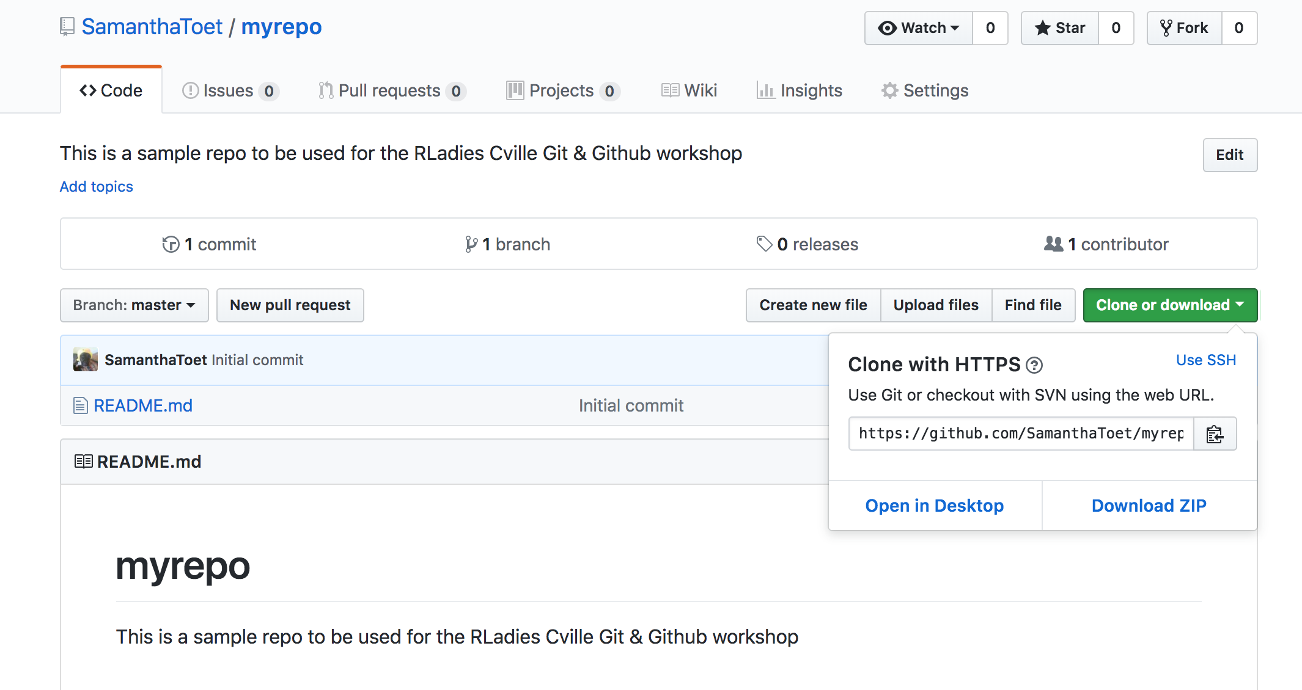

Slide 19
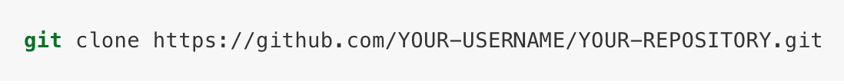
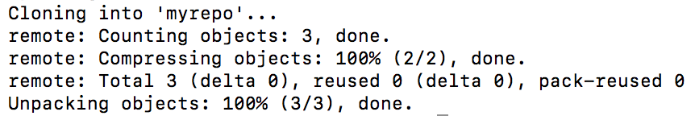
4.3.) Clone the Github Repository
In your terminal, type git clone and then paste the repo URL you copied in the previous step
What you type should look something like this:
Your console should print something like this:
Check out the new folder on your desktop!

Slide 20
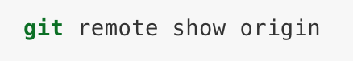
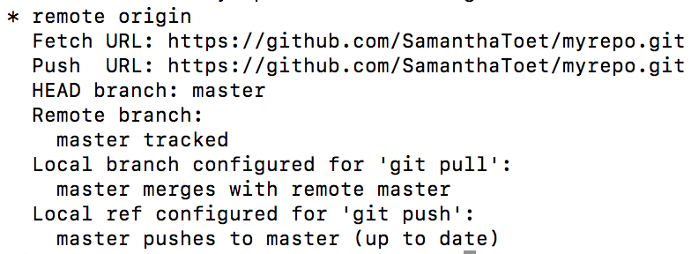
4.4.) Link to the Github Repository
In your terminal make the repo your new working directory, and view its contents:
Change directory: cd myrepo
List files: ls (should print README.md)
Get some information on the connection to Github. In your terminal type:
Your output should look something like this:
Notes:
Explain what each step does:
Fetch
Push

Slide 21
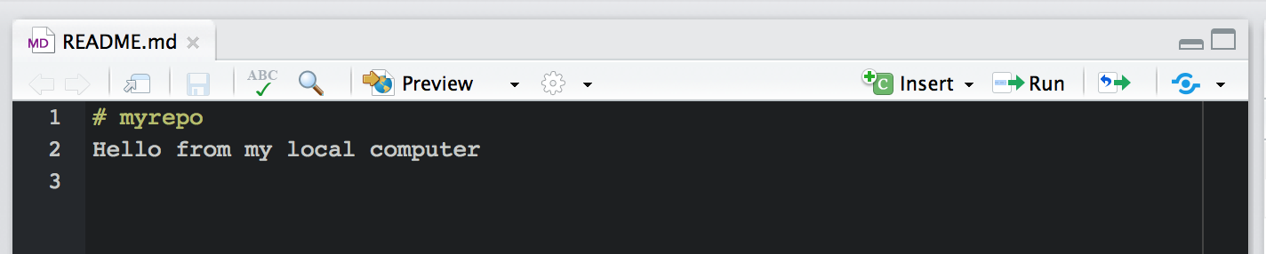
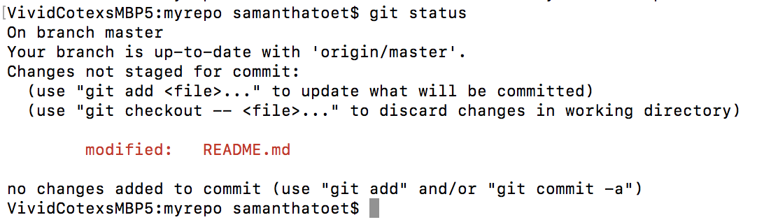
5.1.) Make a local change and check status
Let’s add a line to the README in Rstudio
Verify that Git noticed the change. Type git status
Notes:
Or use Echo “” >> README.md
Breakdown what each line means:
Branch master
Red, modified

Slide 22

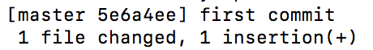
5.2.) Commit the change to Staging
Type git add –A to add the change in the working directory to the staging area (i.e. it tell Git to track the file)
New Github users will be prompted for their username and pw
Commit the change to staging with a message using -m
Your output should look something like this:
Notes:
Add vs. commit (package up)
-m flag
Describe output

Slide 23
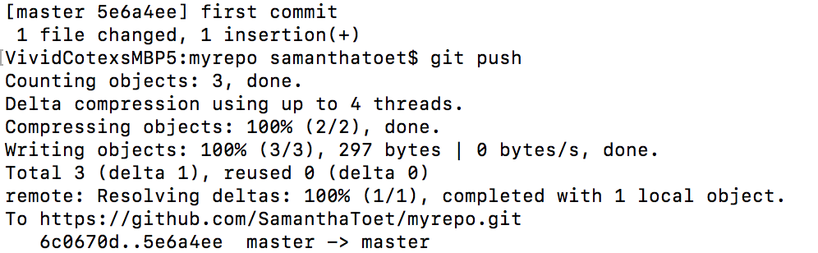
5.3.) Push the change to Github
Type git push to push the staged files to Github
In your browser, refresh Github – you should now see your new commit
Notes:
Add vs. commit (package up)
-m flag
Describe output

Slide 24
Congrats!
You have successfully synced your local project to the internet!

Slide 25
You can do everything we just did from Rstudio
To clone your remote repo to local:
Create a new repo on Github, initialize with a README, and clone the URL
Set your working directory in Rstudio
In Rstudio, start a new project: File > New Project > Version Control > Git
Paste the URL of your new Github repo
Check “Open New Session” and then “Create Project”
You should now see the file README.md in Rstudio’s file browser pane
Notes:
Add vs. commit (package up)
-m flag
Describe output

Slide 26
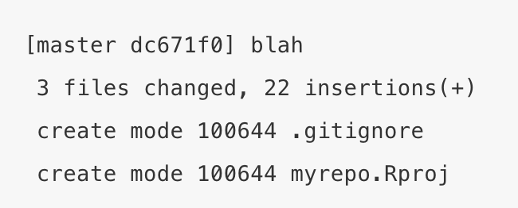
You can do everything we just did from Rstudio
To make local changes, save, commit, and push them to Github:
Modify the README.md file in Rstudio and save
From Rstudio, click the Git tab in the upper right pane
Check the Staged box for README.md
Click Commit and in the pop up type your commit message (EX. “first commit from Rstudio”)
Click Commit, then the green Push button. You should see something like this:
In your browser, refresh Github – you should now see your new commit!

Slide 27
This is what we just did
Questions?
This is what we are about to do
Notes:
What did you just do? Walkthrough

Slide 28
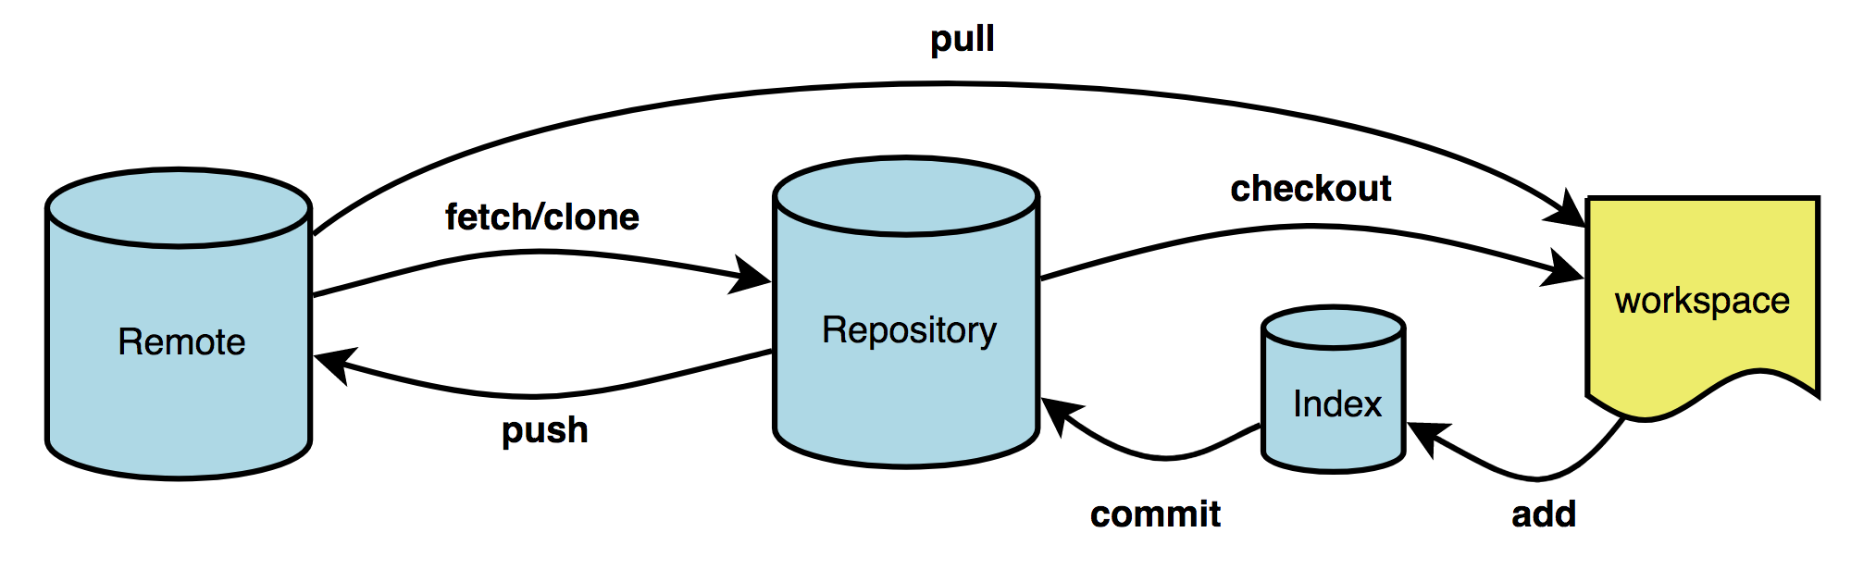
Collaborating
In a collaborative repo, the origin/master might be ahead of yours so you can’t just push your content to it. So what do you do?
First make sure you’ve comfortable moving around repositories:
Use git diff to check the difference between the remote and the local repo: git diff master origin/master will check the differences between the latest commit locally (master) and latest commit remotely (origin/master)
For retrieving a repository that you don’t have, use git clone (you already did this with your own repo!)
For switching between branches in a repo you already have, use git checkout
Notes:
Remember:
origin is remote
master is the local branch
origin/master is a remote branch (a local copy of the branch named "master" on the remote named "origin")
Forking, Pulling, Merging, Checkout

Slide 29
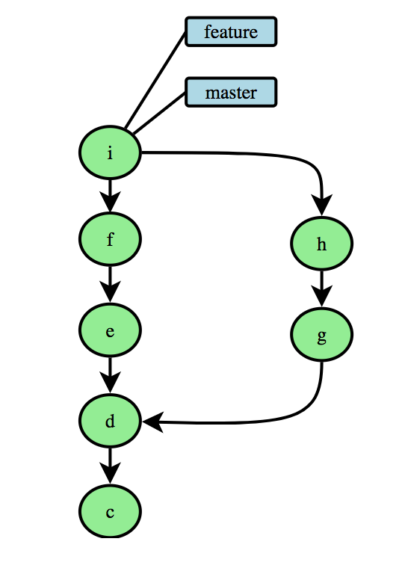
Take their content > Edit > Merge back to Origin
There are a couple of ways to do this:
Forking (Github, not Git) – make a personal copy of another repo that lives in your Github. You can make changes to the project without affecting the original, and keep it up to date by pulling changes from the original. To update your changes to the original, submit a pull request.
Fetching - get the latest changes from an online repo without merging them in. Once these changes are fetched you can compare them to your local branches.
Pulling (git pull) - fetch the latest from the remote and merge them into you changes. Note: this might result in a merge conflict that has to be resolved. You can also do a git pull –rebase which will pull commits from remote, and rebase your current commits on top of the upstream changes. TLDR; it will commit your changes on top of what others have done.
Notes:
Remember:
origin is remote
master is the local branch
origin/master is a remote branch (a local copy of the branch named "master" on the remote named "origin")
Forking, Pulling, Merging, Checkout

Slide 30
Troubleshooting – there’s gonna be a lot of it
Explore history:
git status checks the status of your current commits
git log shows all latest logs (can take additional args for timestamps, regex, etc.
git log --oneline --graph shows a graphical representation including branching
git log --follow file.ext shows version history of a file
Try some resets:
git reset <ref> resets to specified commit, changes are in the working directory rather than the staging area.
git reset -–soft <ref> resets to specified commit, but will keep changes in the staging area
git reset -–hard <ref> resets to specified commit. Clears working directory and staging area so all later work is gone.

Slide 31

Resources
https://www.sourcetreeapp.com/ - helpful GUI for navigating the command line
https://github.com/suzanbaert/Resources_and_Bookmarks - fellow R-Lady
http://happygitwithr.com/ - yass queen
https://git-scm.com/book/en/v2 - Pro Git ebook
https://www.codecademy.com/learn/learn-git - Codeacademy ($)
https://www.codeschool.com/courses/git-real - Code School ($)
https://help.github.com/articles/git-and-github-learning-resources/ - Github documentation

